Slide 1
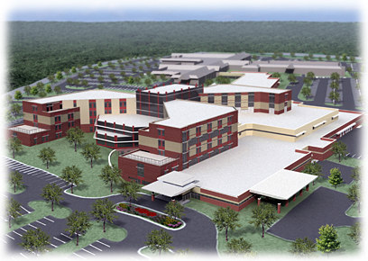
The Washington County Regional Medical Center
Scott Earley
Construction Management
Consultant:
Dr. David Riley
Penn State Senior Thesis April 14, 2009

Slide 2
Presentation Outline
Project Introduction
Project Overview and Background
Analysis 1: Developing the Previous Facilities
Analysis 2: Redesign of the Deep Foundation System
Analysis 3: Composite Precast Panel Unit Implementation
Conclusions
Q & A

Slide 3
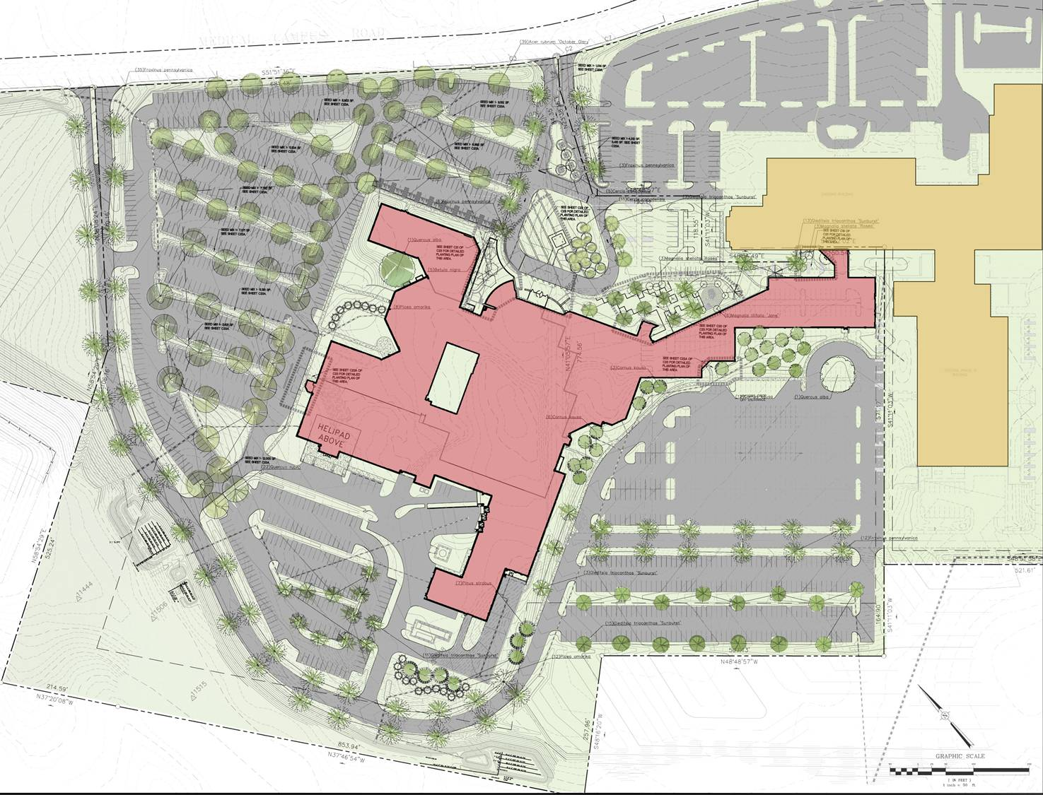


Project Introduction
Outline
Project Introduction
Project Overview
Analysis 1: Developing the Previous Facility
Washington County Regional Medical Center
Location: 11116 Medical Campus Drive
Hagerstown, MD 21742
Robinwood Medical Center
Owner: Washington County Health System
New Medical Center
Architect: Matthei & Colin Associates
Analysis 2: Redesign of Deep Foundation System
Analysis 3: Composite Precast Panel Unit Implementation
Conclusion
Construction Manager: Gilbane Building Company

Slide 4
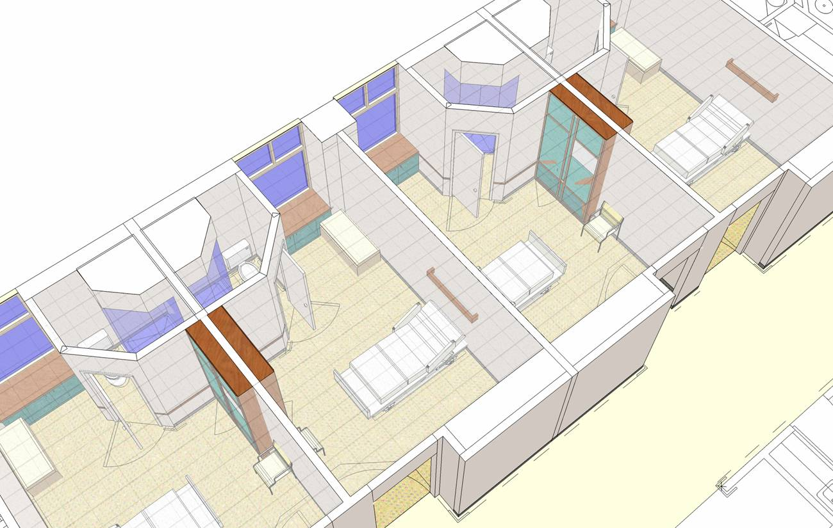
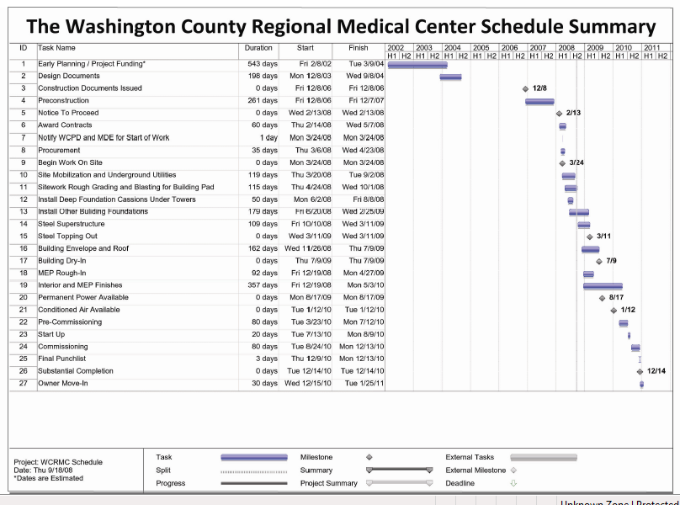
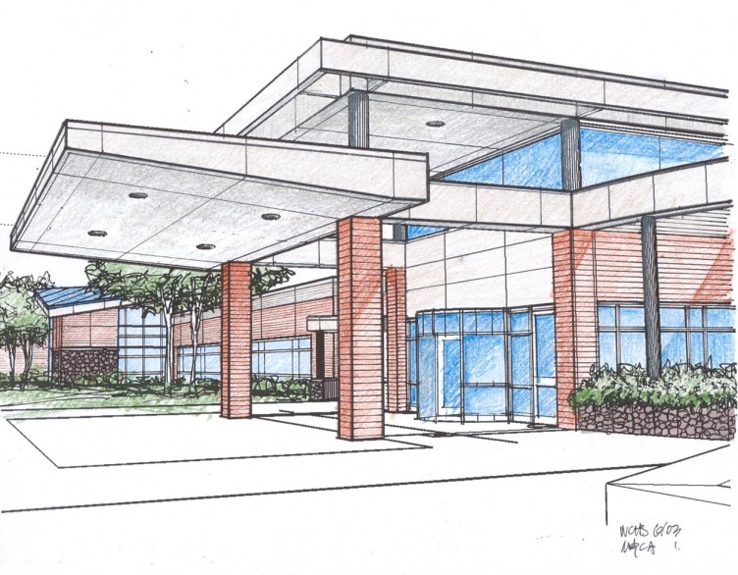
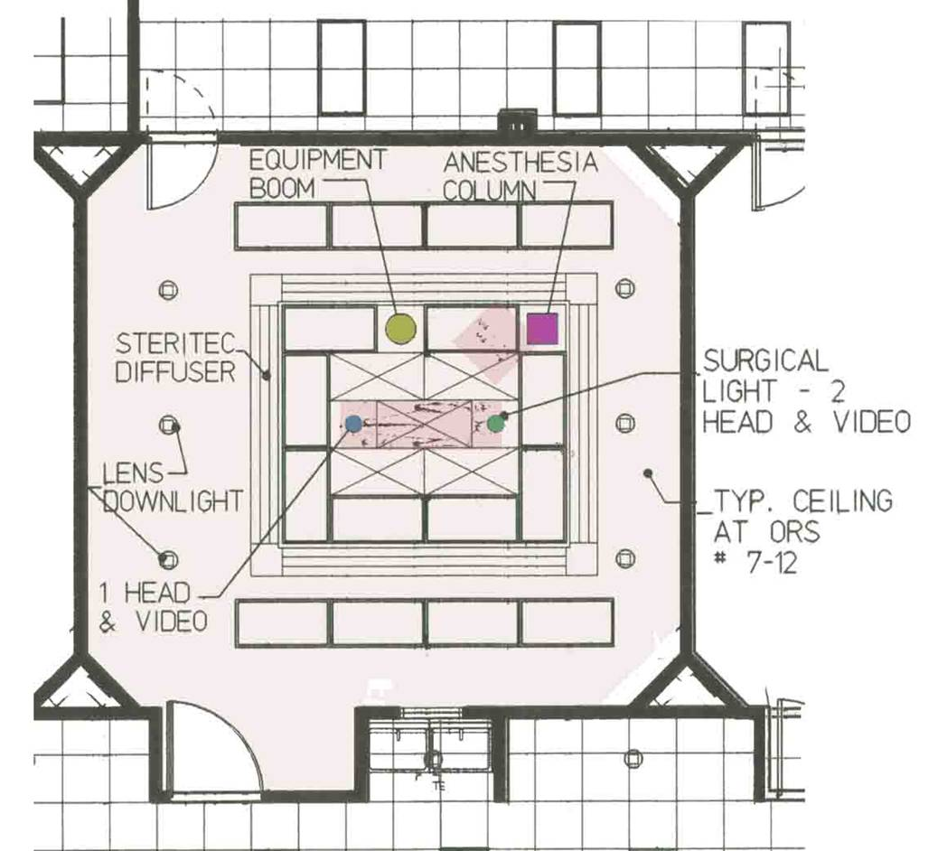
Project Overview
Outline
Project Introduction
Project Overview
Analysis 1: Developing the Previous Facility
Architecture
  500,000 SF
  (275) Single Patient Rooms
  (53) Emergency Treatment Rooms
  (2) Trauma and (2) Cardiac Rooms
  Brick, Architectural Precast Concrete, and Curtain Wall
Total Project Costs
$282 million
$564 /SF
Construction Costs
$150 million
$300 /SF
Analysis 2: Redesign of Deep Foundation System
Analysis 3: Composite Precast Panel Unit Implementation
Conclusion
Construction
  Budget
  Schedule
  Project Delivery Method

Slide 5
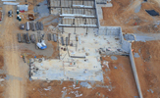
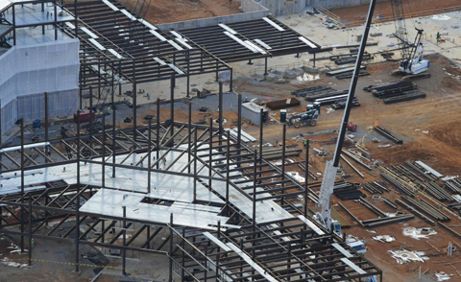
Project Overview
Outline
Project Introduction
Project Overview
Analysis 1: Developing the Previous Facility
Structure
Mechanical
  (5) AHU’s totaling 450,000 cfm
  (2) Chillers & (2) Cooling Towers
Electrical
  (3) Substations each at 4,000 amps, 480Y/277, 13.2kV
Analysis 2: Redesign of Deep Foundation System
Analysis 3: Composite Precast Panel Unit Implementation
Conclusion

Slide 6
Analysis 1
Developing the Previous Facility
Construction Management Depth
MAE Requirement

Slide 7
Analysis 1: Developing the Previous Facility
Outline
Project Introduction
Project Overview
Analysis 1: Developing the Previous Facility
Problem:
Current financial times make it hard for owners to let old facilities to sit idle because of escalating costs. Old facilities become forgotten, vacant, and unused
MARKET ANALYSIS
Market | Construction Spending
Retail and Office Construction | -20%
Hotel Market (Typically Resorts) | -10%
K through 12 | -0.6%
Higher Education | 17%
Healthcare | 26%
Religious | -8%
Public Construction | 13%
Goals:
Generate additional income for the owner by developing former buildings with limited cost impacts. Show additional income can help repay bonds
Analysis 2: Redesign of Deep Foundation System
Analysis 3: Composite Precast Panel Unit Implementation
Conclusion
Data courtesy of the publication Consulting-Specifying Engineer titled
2009 Economic Outlook and was published January 1, 2009

Slide 8
Analysis 1: Developing the Previous Facility
Outline
Project Introduction
Project Overview
Analysis 1: Developing the Previous Facility
MARKET ANALYSIS
Market | Construction Spending
Retail and Office Construction | -20%
Hotel Market (Typically Resorts) | -10%
K through 12 | -0.6%
Higher Education | 17%
Healthcare | 26%
Religious | -8%
Public Construction | 13%
Analysis 2: Redesign of Deep Foundation System
Analysis 3: Composite Precast Panel Unit Implementation
Conclusion
Data courtesy of the publication Consulting-Specifying Engineer titled
2009 Economic Outlook and was published January 1, 2009
Data courtesy of the United States Census Bureau

Slide 9
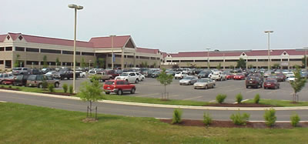
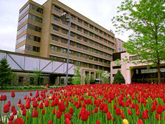
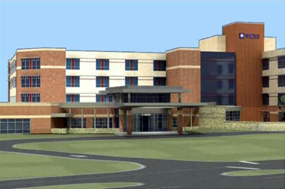
Analysis 1: Developing the Previous Facility
Outline
Project Introduction
Project Overview
Analysis 1: Developing the Previous Facility
Complete Healthcare Services
Robinwood – Outpatient Facility
Old Hospital – Proposed Nursing Home
Analysis 2: Redesign of Deep Foundation System
Analysis 3: Composite Precast Panel Unit Implementation
Conclusion
Data courtesy of the United States Census Bureau
New Medical Center

Slide 10
Analysis 1: Developing the Previous Facility
Outline
Project Introduction
Project Overview
Analysis 1: Developing the Previous Facility
Complete Healthcare Services
NURSING HOME MARKET
Findings | Semi-Private Rooms
2008 Average Rate | $191
2007 Average Rate | $189
2008 Maryland Average | $218
Growth | 1.1%
Capitalization Rate | 12.75%
Robinwood – Outpatient Facility
Old Hospital – Proposed Nursing Home
Analysis 2: Redesign of Deep Foundation System
Analysis 3: Composite Precast Panel Unit Implementation
Conclusion
Data courtesy of The MetLife Market Survey of Nursing Home and Assisted living Costs and The National Investment Center for the Seniors Housing and Care Industry
New Medical Center

Slide 11
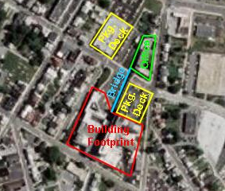
Analysis 1: Developing the Previous Facility
Outline
Project Introduction
Project Overview
Analysis 1: Developing the Previous Facility
Budget Establishment
Quick Background
BUDGET`
Demolition
Item | Cost ($/SF) | Total Cost
Demolition (All) | $19.50 | $10,725,000.00
Rennovation
Item | Cost ($/SF) | Total Cost
Replacement Windows |  | $300,000.00
New Roofing | $3.03 | $238,070.13
Upgrades, Cleaning, Inspection
Mechanical | $17.98 | $5,735,620.00
Electrical | $8.06 | $1,152,580.00
Plumbing | $4.96 | $436,480.00
Elevator Inspections, Repairs, and Upgrades |  | $95,000.00
All Interior Work | $18.45 | $10,147,500.00
Total Rennovation Costs |  | $28,830,250.13
550,000 SF
7 stories
(264) Beds
Total Renovation Costs | $28,830,250.13
Analysis 2: Redesign of Deep Foundation System
Analysis 3: Composite Precast Panel Unit Implementation
Conclusion

Slide 12
Analysis 1: Developing the Previous Facility
Outline
Project Introduction
Project Overview
Analysis 1: Developing the Previous Facility
Initial Schedule Development
DEVELOP TO SELL SUMMARY
Total Design and Construction Costs | $34,475,474
Net Development Return | $94,238,703
Gross Residual Value | $59,763,229
Sale Price | $126,799,059
Land Value¹ | $1,915,000
Return on Investment | $92,323,585
SCHEDULE
Demolition
Item | Daily Output (SF/Day) | Total Duration
Demolition (All) | 500 | 55
Rennovation
Item | Daily Output (SF/Day) | Total Duration
Replacement Windows |  | 10
New Roofing | 50 | 20
Upgrades, Cleaning, Inspection
Mechanical | 200 | 28
Electrical | 250 | 22
Plumbing | 415 | 13
Elevator Inspections, Repairs, and Upgrades |  | 5
All Interior Work | 610 | 90
Total Rennovation Schedule |  | 243
Development Options
Develop to Sell
Develop to Run
Total Renovation Schedule | 243
DEVELOP TO RUN SUMMARY
Sale Price @ 10th year | $144,325,571
Return on Investment | $99,850,097
Internal Rate of Return | 32%
Analysis 2: Redesign of Deep Foundation System
Analysis 3: Composite Precast Panel Unit Implementation
Conclusion

Slide 13
Analysis 1: Developing the Previous Facility
Outline
Project Introduction
Project Overview
Analysis 1: Developing the Previous Facility
Development Options
PARTIALLY DEVELOP TO RUN SUMMARY
Sale Price @ 10th year | $74,264,614
Return on Investment | $50,117,002
Internal Rate of Return | 31%
Develop to Sell
Develop to Run
Partially Develop to Run
Develop to Lease
DEVELOP TO LEASE SUMMARY
Sale Price @ 10th year | $69,925,736
Return on Investment | $35,450,262
Internal Rate of Return | 25%
Analysis 2: Redesign of Deep Foundation System
Analysis 3: Composite Precast Panel Unit Implementation
Conclusion

Slide 14
Analysis 1: Developing the Previous Facility
Outline
Project Introduction
Project Overview
Analysis 1: Developing the Previous Facility
Conclusion and Recommendations
Financial times may be tough; however, the right development may be a worthy investment
Partially Develop to Run
  Construction Costs Low
  WCHS is capable of management
  Help repay bonds on new medical center
Analysis 2: Redesign of Deep Foundation System
Analysis 3: Composite Precast Panel Unit Implementation
Conclusion

Slide 15
Analysis 2
Redesign of Deep Foundation System
Structural Breadth

Slide 16
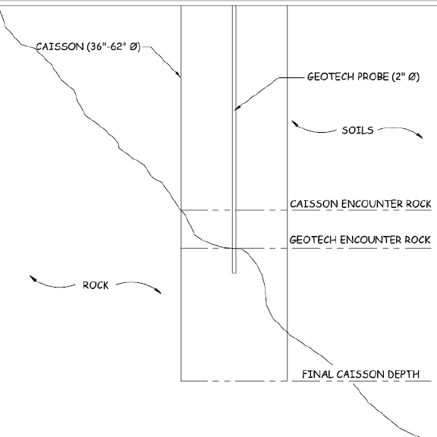
Analysis 2: Redesign of Deep Foundation
Outline
Project Introduction
Project Overview
Analysis 1: Developing the Previous Facility
Problem:
Current deep foundation system, 150 caissons, has created multiple issues because of subsurface rock conditions and the inability for the entire caisson to rest on adequate bearing rock.
Goals:
Develop a more appropriate system that meets or exceeds all contract specifications while reducing costs.
Analysis 2: Redesign of Deep Foundation System
Analysis 3: Composite Precast Panel Unit Implementation
Conclusion

Slide 17
Analysis 2: Redesign of Deep Foundation
Outline
Project Introduction
Project Overview
Analysis 1: Developing the Previous Facility
Initial Alternate Foundation Analysis
Mat Foundation
Piles
  End Bearing
  Friction
Geopiers
Minipiles
Analysis 2: Redesign of Deep Foundation System
Analysis 3: Composite Precast Panel Unit Implementation
Conclusion

Slide 18
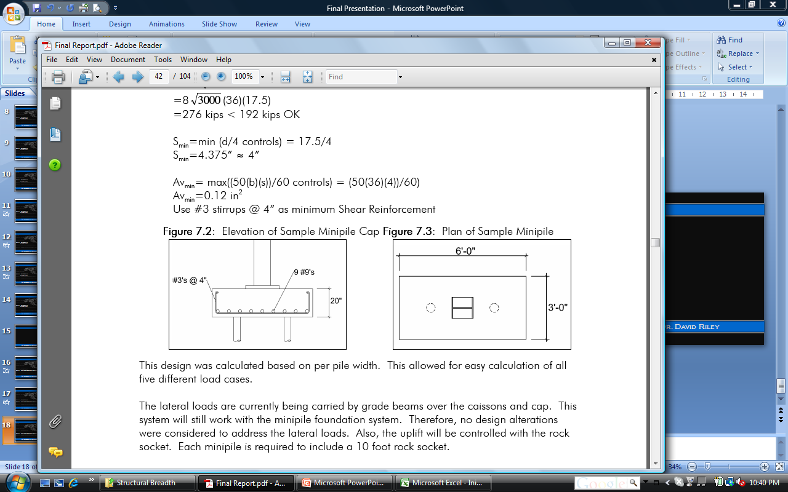
Analysis 2: Redesign of Deep Foundation
Outline
Project Introduction
Project Overview
Analysis 1: Developing the Previous Facility
Minipile Deep Foundation System Design
Schedule Review
250 kips per pile
5 inch diameter
10 foot rock socket
SCHEDULE COMPARISON
Construction Time
System | Quantity | Unit | Output (Unit/Day) | Total (Days)
Caissons | 150.0 | Caissons | 1.5 | 103.0
Minipiles | 532.0 | Minipiles | 11.0 | 53.2
 |  |  | Difference | 49.8
 |  |  | % Reduction | 48.3%
% Reduction | 48.3%
Analysis 2: Redesign of Deep Foundation System
Analysis 3: Composite Precast Panel Unit Implementation
Conclusion
2 minipiles
4 minipiles
5 minipiles
6 minipiles
8 minipiles

Slide 19
Analysis 2: Redesign of Deep Foundation
Outline
Project Introduction
Project Overview
Analysis 1: Developing the Previous Facility
Budget Review
Schedule Review
COST COMPARISON
System | Labor ($) | Material ($) | Equipment ($) | Total
Caissons | $759,826.61 | $295,632.12 | $798,114.90 | $1,853,573.62
Mininpiles | $520,383.27 | $203,568.88 | $585,336.19 | $1,440,217.16
Difference |  |  |  | $413,356.46
% Reduction |  |  |  | 22.3%
SCHEDULE COMPARISON
Construction Time
System | Quantity | Unit | Output (Unit/Day) | Total (Days)
Caissons | 150.0 | Caissons | 1.5 | 103.0
Minipiles | 532.0 | Minipiles | 11.0 | 53.2
 |  |  | Difference | 49.8
 |  |  | % Reduction | 48.3%
% Reduction | 22.3%
% Reduction | 48.3%
Analysis 2: Redesign of Deep Foundation System
Analysis 3: Composite Precast Panel Unit Implementation
Conclusion

Slide 20
Analysis 2: Redesign of Deep Foundation
Outline
Project Introduction
Project Overview
Analysis 1: Developing the Previous Facility
Conclusion and Recommendations
Minipile foundation provides a shorter schedule and cost reduction
Fits much better with WCHS goals and plans
Safer for construction workers
Analysis 2: Redesign of Deep Foundation System
Analysis 3: Composite Precast Panel Unit Implementation
Conclusion

Slide 21
Analysis 3
Composite Precast Panel Unit Implementation
Mechanical Breadth

Slide 22
Analysis 3: Composite Precast Panel Units
Outline
Project Introduction
Project Overview
Analysis 1: Developing the Previous Facility
Problem:
The masonry work starts in the winter and can be a long labor intensive activity and, with rising energy costs and other labor and material costs, composite precast implementation worth investigation.
Goals:
Simplify the construction of the exterior brick façade by reducing the schedule and thereby, shortening the critical path. Also, enhance the thermal properties of the wall system and reduce the size of the AHU’s
Analysis 2: Redesign of Deep Foundation System
Analysis 3: Composite Precast Panel Unit Implementation
Conclusion

Slide 23
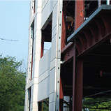
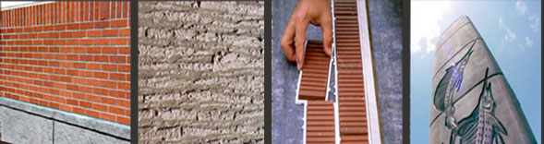
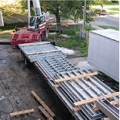
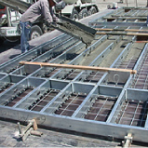
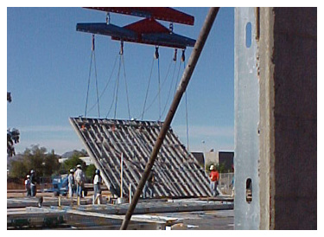
Analysis 3: Composite Precast Panel Units
Outline
Project Introduction
Project Overview
Analysis 1: Developing the Previous Facility
Metal Stud Crete ®
Meeting the Goals
Achieving the brick look with
The Scott System ®
LEED
Mesh contains 30%-80% recycled content
Locally extracted materials
Lighter = Less transportation
2” Thick Concrete
Insulation
Light Gauge Framing
Analysis 2: Redesign of Deep Foundation System
Analysis 3: Composite Precast Panel Unit Implementation
Conclusion

Slide 24
Analysis 3: Composite Precast Panel Units
Outline
Project Introduction
Project Overview
Analysis 1: Developing the Previous Facility
SCHEDULE COMPARISON
Lead Times
System | Quantity | Unit | Output (Unit/Day) |  | Total (Days)
Brick | 12927.0 | SF | --------------- |  | 70.0
*Metal Stud Crete® | 12927.0 | SF | --------------- |  | 103.3
Difference |  |  |  |  | 33.3
% Increase |  |  |  |  | 32.2%
Construction Time
System | Quantity | Unit |  | Output (Unit/Day) | Total (Days)
Brick | 12927.0 | SF |  | 190.0 | 68.0
Metal Suds | 6093.0 | LF |  | 450.0 | 13.5
Metal Stud Crete® | 12927.0 | SF |  | 853.0 | 15.2
 |  |  |  | Difference | 66.4
 |  |  |  | % Reduction | 81.4%
Lead Time % Increase | 48.3%
Construction Time % Reduction | 81.4%
Analysis 2: Redesign of Deep Foundation System
Analysis 3: Composite Precast Panel Unit Implementation
Conclusion

Slide 25
Analysis 3: Composite Precast Panel Units
Outline
Project Introduction
Project Overview
Analysis 1: Developing the Previous Facility
SCHEDULE COMPARISON
Lead Times
System | Quantity | Unit | Output (Unit/Day) |  | Total (Days)
Brick | 12927.0 | SF | --------------- |  | 70.0
*Metal Stud Crete® | 12927.0 | SF | --------------- |  | 103.3
Difference |  |  |  |  | 33.3
% Increase |  |  |  |  | 32.2%
Construction Time
System | Quantity | Unit |  | Output (Unit/Day) | Total (Days)
Brick | 12927.0 | SF |  | 190.0 | 68.0
Metal Suds | 6093.0 | LF |  | 450.0 | 13.5
Metal Stud Crete® | 12927.0 | SF |  | 853.0 | 15.2
 |  |  |  | Difference | 66.4
 |  |  |  | % Reduction | 81.4%
COST COMPARISON
Bare Costs
System | Quantity | Unit | Cost ($/SF) | Total Cost
Brick | 12927.0 | SF | $35.00 | $452,445.00
*Metal Stud Crete® | 12927.0 | SF | $45.00 | $581,715.00
Difference |  |  |  | $129,270.00
% Increase |  |  |  | 28.6%
Related Costs
Item | Quantity | Unit | Cost ($/Unit) | Total Cost
Add:
Crane (15 Days) | 120.0 | hrs. | $350.00 | $42,000.00
Sub-Total |  |  |  | $42,000.29
Less:
Scaffold | 1500.0 | SFCA | $252.00 | $378,000.00
Exterior Framing | 6093.0 | LF | $21.00 | $127,953.00
Total Savings |  |  |  | $463,952.71
% Savings |  |  |  | 48.4%
Lead Time % Increase | 48.3%
Construction Time % Reduction | 81.4%
Bare Costs % Increase | 28.6%
Total Costs % Savings | 48.4%
Analysis 2: Redesign of Deep Foundation System
Analysis 3: Composite Precast Panel Unit Implementation
Conclusion

Slide 26
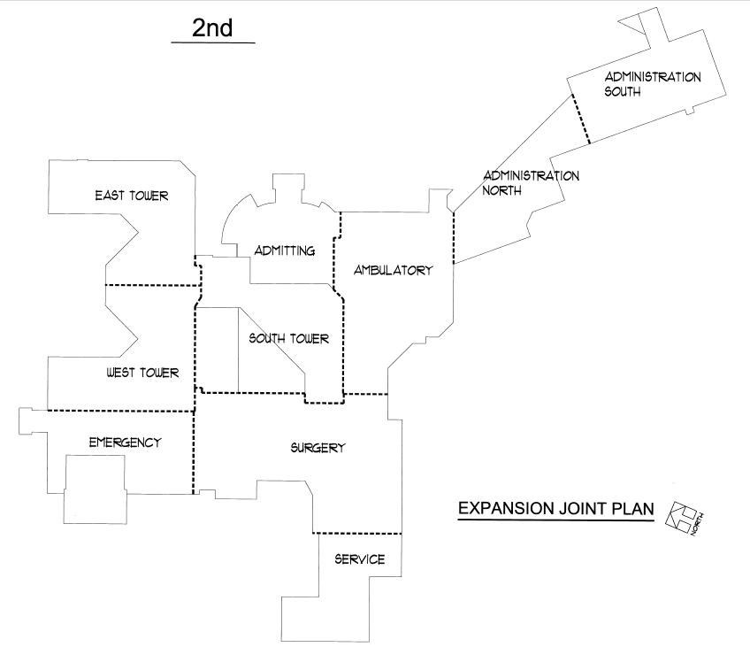
Analysis 3: Composite Precast Panel Units
Outline
Project Introduction
Project Overview
Analysis 1: Developing the Previous Facility
Original Sequencing
New Sequencing
SEQUENCING ORDER
# | Area
1 | South Tower
2 | West Tower
3 | East Tower
4 | Service Building
5 | Admin (or Link) North
6 | Admin (or Link) South
7 | Admitting
8 | Ambulatory
9 | Emegency
10 | Surgery
SEQUENCING ORDER
# | Area
1 | South Tower
2 | West Tower
3 | East Tower
4 | Emergency
5 | Service Building
6 | Surgery
7 | Ambulatory
8 | Admitting
9 | Admin (or Link) South
10 | Admin (or Link) North
Analysis 2: Redesign of Deep Foundation System
Analysis 3: Composite Precast Panel Unit Implementation
Conclusion

Slide 27
Analysis 3: Composite Precast Panel Units
Outline
Project Introduction
Project Overview
Analysis 1: Developing the Previous Facility
THERMAL ANALYSIS
Summer Heat Gain (T_{o} = 89, T_{i} = 72)
System | Area (SF) | U-Value | ∆T (ºF) | Heat Gain (BTU/Hr)
Brick Cavity Wall | 12927.0 | 0.325 | 17 | 71421.68
Metal Stud Crete® | 12927.0 | 0.300 | 17 | 65927.70
 |  | Difference |  | 137349.38
 |  | Reduction in Heat Gain |  | 7.69%
THERMAL ANALYSIS
Winter Heat Loss (T_{o} = 11, T_{i} = 69)
System | Area (SF) | U-Value | ∆T (ºF) | Heat Gain (BTU/Hr)
Brick Cavity Wall | 12927.0 | 0.325 | 58 | 243673.95
Metal Stud Crete® | 12927.0 | 0.300 | 58 | 224929.80
 |  | Difference |  | 468603.75
 |  | Reduction in Heat Loss |  | 7.69%
Reduction in Heat Gain | 7.69%
Reduction in Heat Loss | 7.69%
Analysis 2: Redesign of Deep Foundation System
Analysis 3: Composite Precast Panel Unit Implementation
Conclusion

Slide 28
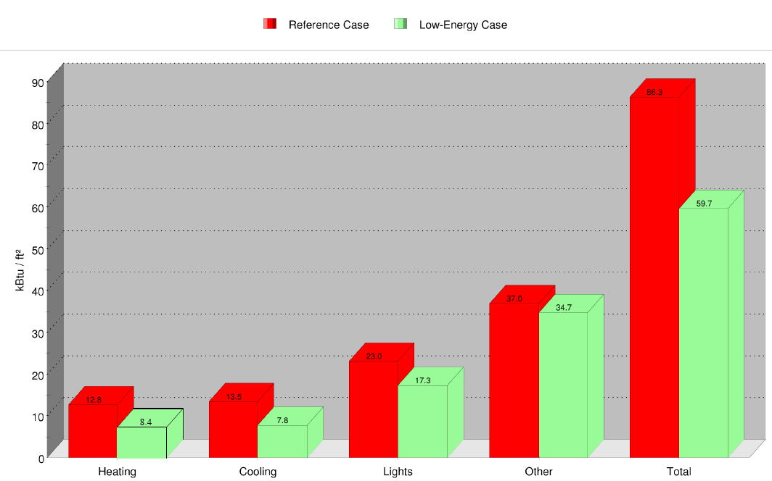
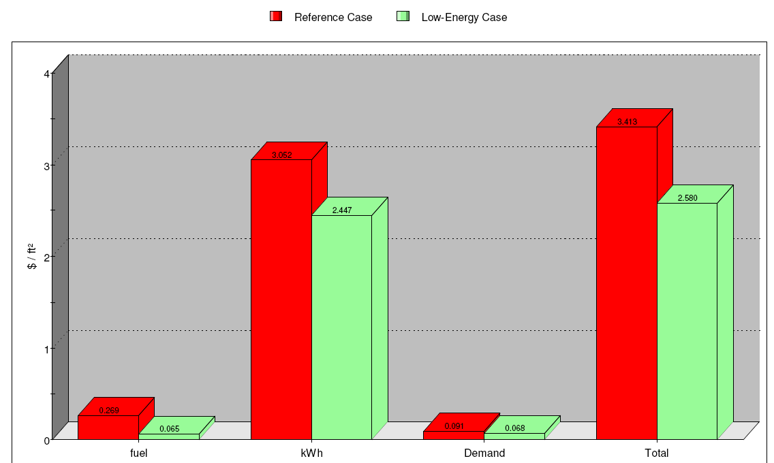
Analysis 3: Composite Precast Panel Units
Outline
Project Introduction
Project Overview
Analysis 1: Developing the Previous Facility
Annual Energy Use
Annual Energy Cost
20%
6.2%
34%
42%
76%
Analysis 2: Redesign of Deep Foundation System
Analysis 3: Composite Precast Panel Unit Implementation
Conclusion
25%

Slide 29
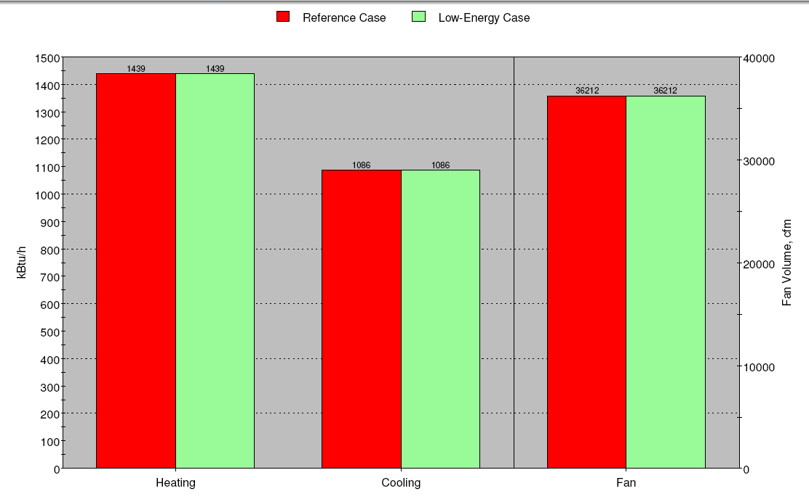
Analysis 3: Composite Precast Panel Units
Outline
Project Introduction
Project Overview
Analysis 1: Developing the Previous Facility
HVAC Capacities
Conclusion and Recommendations
Composite wall system is faster and, including all factors, cheaper.
Lead time is longer.
Energy costs are lower.
Demand is not reduced enough to re-size units.
Analysis 2: Redesign of Deep Foundation System
Analysis 3: Composite Precast Panel Unit Implementation
Conclusion

Slide 30
Conclusion
Outline
Project Introduction
Project Overview
Analysis 1: Developing the Previous Facility
Completing the Picture
PARTIALLY DEVELOP TO RUN W/ SAVINGS SUMMARY
Sale Price @ 10th year | $74,264,614
Return on Investment | $50,865,041
Internal Rate of Return | 34%
COMPARISON
 | PDTR | PDTRwS
Sale Price @ 10th year | $74,264,614 | $74,264,614
Return on Investment | $50,117,002 | $50,865,041
Internal Rate of Return | 31% | 34%
Analysis 2: Redesign of Deep Foundation System
Analysis 3: Composite Precast Panel Unit Implementation
Conclusion

Slide 31
Conclusion
Outline
Project Introduction
Project Overview
Analysis 1: Developing the Previous Facility
Development
With the proper development, an owner can contribute to their income by developing their previous facility.
Thesis Conclusion
Deep Foundation Redesign with Minipiles
22% reduction in cost and 48% reduction in schedule.
Analysis 2: Redesign of Deep Foundation System
Analysis 3: Composite Precast Panel Unit Implementation
Conclusion
Composite Precast Implementation
48% reduction in cost and 81% reduction in schedule. 7.69% reduction in summer heat gain and winter heat loss

Slide 32
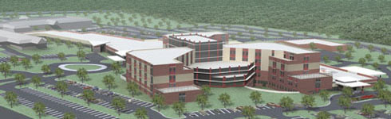
Outline
Project Introduction
Project Overview
Analysis 1: Developing the Previous Facility
Acknowledgments
Questions?
Washington County Health System
Gilbane Building Company – especially Matt Sarver, Gary Orton, and Fred Neighoff
Penn State AE faculty– especially Dr. Riley and Dr. Horman
Fellow AE students
Karen Borst and Foster Earley
Ryan and Todd Earley
Tom, Julie, and Megan Ramsey
‘’’Hawks 4 Life’’’ – David Miller and Steve Lumpp
Thomas Chirdon, Dominic Manno, and Christopher Conrad
Analysis 2: Redesign of Deep Foundation System
Analysis 3: Composite Precast Panel Unit Implementation
Conclusion

Slide 33
Develop to Run
Develop to Sell
Develop to Sell Cont’d
Development Returns
Efficiency Rate | 75%
 | # of Beds | Rent | Cost
Nursing Home | 206 | $78,480 | $16,166,880
 | Gross Rent |  | $16,166,880
 | Capitalization Rate |  | 12.75%
Gross Returns / Sale Price |  |  | $126,799,059
Less the Following:
Marketing/Advertising |  | 1% | $1,255,436
 |  |  | $125,543,623
Agents Commission |  | 1.50% | $1,855,324
 |  |  | $123,688,298
 | Legals | 5% | $5,889,919
 |  |  | $117,798,379
 | Vacancies | 25% | $23,559,676
 |  |  | $94,238,703
 | Net Proceeds |  | $94,238,703
Gross Residual Value |  |  | $59,763,229
Less Interest Holding Charges |  | 2% | $1,171,828
 |  |  | $58,591,401
 | Less Taxes | 1.858% | $1,068,770
 |  |  | $57,522,631
 |  | Net Residual Value is: | $57,522,631
DEVELOP TO RUN DISCOUNTED CASH FLOW
Construciton Costs |  |  | $34,475,474
Initial Net Income |  |  | $16,166,880
Initial Cap. Rate |  |  | 12.75%
Reversionary Cap Rate |  |  | 13%
Growth |  |  | 1.5%
Market Reviews |  |  | 2 yearly
Refurbishment Cost |  |  | $10,000,000
Effeciency Rate |  |  | 75%
Year | Construction Costs | Growth (%) | Income | Room Rate | Refurb Cost | Growth (%) | Operating Costs | Sale Price | Net Cash Flow | PV Factor | Discounted Cash Flow | PV Factor | Discounted Cash Flow
 |  |  |  |  |  |  |  |  |  | 30% |  | 35%
0 | -$34,475,474 | 0 |  |  |  |  |  |  | -$34,475,474 | 1 | -$34,475,474 | 1 | -$34,475,474
1 |  | 1.5% | $16,166,880 | $16,166,880 |  | 0 | 6,951,758 |  | $9,215,122 | 0.7693 | $7,089,193 | 0.7408 | $6,826,562
2 |  | 1.5% | $16,409,383 | $16,166,880 |  | 1.5% | 6,951,758 |  | $9,215,122 | 0.5918 | $5,453,509 | 0.5487 | $5,056,337
3 |  | 1.5% | $16,655,524 | $16,655,524 |  | 1.5% | 7,056,035 |  | $9,599,489 | 0.4552 | $4,369,687 | 0.4065 | $3,902,192
4 |  | 1.5% | $16,905,357 | $16,655,524 |  | 1.5% | 7,161,875 |  | $9,493,649 | 0.3502 | $3,324,676 | 0.3011 | $2,858,538
5 |  | 1.5% | $17,158,937 | $17,158,937 | $10,000,000 | 1.5% | 7,269,303 |  | -$110,366 | 0.2694 | -$29,733 | 0.2231 | -$24,623
6 |  | 1.5% | $17,416,321 | $17,158,937 |  | 1.5% | 7,378,343 |  | $9,780,594 | 0.2072 | $2,026,539 | 0.1652 | $1,615,754
7 |  | 1.5% | $17,677,566 | $17,677,566 |  | 1.5% | 7,489,018 |  | $10,188,548 | 0.1594 | $1,624,055 | 0.1224 | $1,247,078
8 |  | 1.5% | $17,942,730 | $17,677,566 |  | 1.5% | 7,601,353 |  | $10,076,213 | 0.1226 | $1,235,344 | 0.0907 | $913,912
9 |  | 1.5% | $18,211,870 | $18,211,870 |  | 1.5% | 7,715,374 |  | $10,496,497 | 0.0943 | $989,820 | 0.0672 | $705,365
10 |  | 1.5% | $18,485,049 | $18,211,870 |  | 1.5% | 7,831,104 | $144,325,571 | $154,706,337 | 0.0726 | $11,231,680 | 0.0498 | $7,704,376
11 |  |  | $18,762,324
 |  |  |  |  |  |  |  |  |  | NPV | $2,839,296 |  | -$3,669,982
 |  |  |  |  |  |  |  |  | IRR | 32%
DEVELOP TO SELL RESIDUAL ANALYSIS
Development Costs
Development Period:
Approvals / Preconstruction | 6 months
Construciton | 12 months
Construction Cost Escalation | 4% per annum
Building Costs
 | # of Beds | Rate | Cost
Nursing Home | 274 | $109,489 | $29,999,986
Construction Costs at April 2009 |  |  | $29,999,986
Cost Escalation Prior to Construction |  |  | $450,000
 | Sub-Total |  | $30,449,986
Cost Escalation During Construction |  |  | $609,000
Total Construction Costs at Completion |  |  | $31,058,986
Consultants' Fees @ 11% |  |  | $3,416,488
Total Design and Construction Costs |  |  | $34,475,474

Slide 34
Partially Develop to Run
Develop to Lease
Partially Develop to Run w Savings
PARTIALLY DEVELOP TO RUN DISCOUNTED CASH FLOW
Construciton Costs |  |  | $18,747,612
Initial Net Income |  |  | $8,318,880
Initial Cap. Rate |  |  | 12.75%
Reversionary Cap Rate |  |  | 13%
Growth |  |  | 1.5%
Market Reviews |  |  | 2 yearly
Refurbishment Cost |  |  | $5,400,000
Effeciency Rate |  |  | 85%
Year | Construction Costs | Growth (%) | Market Rent | Lease Rent | Refurb Cost | Growth (%) | Operating Costs | Sale Price | Net Cash Flow | PV Factor | Discounted Cash Flow | PV Factor | Discounted Cash Flow
 |  |  |  |  |  |  |  |  |  | 30% |  | 35%
0 | -$18,747,612 | 0 |  |  |  |  |  |  | -$18,747,612 | 1 | -$18,747,612 | 1 | -$18,747,612
1 |  | 1.5% | $8,318,880 | $8,318,880 |  | 0 | 3,577,118 |  | $4,741,762 | 0.7693 | $3,647,837 | 0.7408 | $3,512,697
2 |  | 1.5% | $8,443,663 | $8,318,880 |  | 1.5% | 3,577,118 |  | $4,741,762 | 0.5918 | $2,806,175 | 0.5487 | $2,601,805
3 |  | 1.5% | $8,570,318 | $8,570,318 |  | 1.5% | 3,630,775 |  | $4,939,543 | 0.4552 | $2,248,480 | 0.4065 | $2,007,924
4 |  | 1.5% | $8,698,873 | $8,570,318 |  | 1.5% | 3,685,237 |  | $4,885,081 | 0.3502 | $1,710,755 | 0.3011 | $1,470,898
5 |  | 1.5% | $8,829,356 | $8,829,356 | $5,400,000 | 1.5% | 3,740,515 |  | -$311,159 | 0.2694 | -$83,826 | 0.2231 | -$69,420
6 |  | 1.5% | $8,961,796 | $8,829,356 |  | 1.5% | 3,796,623 |  | $5,032,733 | 0.2072 | $1,042,782 | 0.1652 | $831,407
7 |  | 1.5% | $9,096,223 | $9,096,223 |  | 1.5% | 3,853,572 |  | $5,242,651 | 0.1594 | $835,679 | 0.1224 | $641,700
8 |  | 1.5% | $9,232,667 | $9,096,223 |  | 1.5% | 3,911,376 |  | $5,184,847 | 0.1226 | $635,662 | 0.0907 | $470,266
9 |  | 1.5% | $9,371,157 | $9,371,157 |  | 1.5% | 3,970,047 |  | $5,401,110 | 0.0943 | $509,325 | 0.0672 | $362,955
10 |  | 1.5% | $9,511,724 | $9,371,157 |  | 1.5% | 4,029,597 | $74,264,614 | $79,606,174 | 0.0726 | $5,779,408 | 0.0498 | $3,964,387
11 |  |  | $9,654,400
 |  |  |  |  |  |  |  |  |  | NPV | $384,665 |  | -$2,952,992
 |  |  |  |  |  |  |  |  | IRR | 31%
DEVELOP TO LEASE DISCOUNTED CASH FLOW
Year | Construction Price | Growth (%) | Income | Room Rate | Refurb Cost | Sale Price | Net Cash Flow | PV Factor | Discounted Cash Flow | PV Factor | Discounted Cash Flow
 |  |  |  |  |  |  |  | 20% |  | 30%
0 | -$34,475,474 | 0 |  |  |  |  | -$34,475,474 | 1 | -$34,475,474 | 1 | -$34,475,474
1 |  | 1.5% | $7,832,853 | $7,832,853 |  |  | $7,832,853 | 0.8334 | $6,527,900 | 0.7693 | $6,025,814
2 |  | 1.5% | $7,950,346 | $7,832,853 |  |  | $7,832,853 | 0.6945 | $5,439,916 | 0.5918 | $4,635,482
3 |  | 1.5% | $8,069,601 | $8,069,601 |  |  | $8,069,601 | 0.5788 | $4,670,685 | 0.4552 | $3,673,282
4 |  | 1.5% | $8,190,645 | $8,069,601 |  |  | $8,069,601 | 0.4823 | $3,891,969 | 0.3502 | $2,825,974
5 |  | 1.5% | $8,313,505 | $8,313,505 | $10,000,000 |  | -$1,686,495 | 0.4019 | -$677,802 | 0.2694 | -$454,342
6 |  | 1.5% | $8,438,207 | $8,313,505 |  |  | $8,313,505 | 0.3349 | $2,784,193 | 0.2072 | $1,722,558
7 |  | 1.5% | $8,564,780 | $8,564,780 |  |  | $8,564,780 | 0.2791 | $2,390,430 | 0.1594 | $1,365,226
8 |  | 1.5% | $8,693,252 | $8,564,780 |  |  | $8,564,780 | 0.2326 | $1,992,168 | 0.1226 | $1,050,042
9 |  | 1.5% | $8,823,651 | $8,823,651 |  |  | $8,823,651 | 0.1939 | $1,710,906 | 0.0943 | $832,070
10 |  | 1.5% | $8,956,006 | $8,823,651 |  | $69,925,736 | $78,749,387 | 0.1616 | $12,725,901 | 0.0726 | $5,717,205
11 |  |  | $9,090,346
 |  |  |  |  |  |  |  | NPV | $6,980,791 |  | -$7,082,161
 |  |  |  |  |  |  | IRR | 25%
PARTIALLY DEVELOP TO RUN DISCOUNTED CASH FLOW WITH SAVINGS
Construciton Costs |  |  | $17,999,573
Initial Net Income |  |  | $8,318,880
Initial Cap. Rate |  |  | 12.75%
Reversionary Cap Rate |  |  | 13%
Growth |  |  | 1.5%
Market Reviews |  |  | 2 yearly
Refurbishment Cost |  |  | $5,400,000
Effeciency Rate |  |  | 85%
Year | Construction Costs | Growth (%) | Market Rent | Lease Rent | Refurb Cost | Growth (%) | Operating Costs | Annual Energy Savings | Sale Price | Net Cash Flow | PV Factor | Discounted Cash Flow | PV Factor | Discounted Cash Flow
 |  |  |  |  |  |  |  |  |  |  | 30% |  | 35%
0 | -$17,999,573 | 0 |  |  |  |  |  |  |  | -$17,999,573 | 1 | -$17,999,573 | 1 | -$17,999,573
1 |  | 1.5% | $8,318,880 | $8,318,880 |  | 0 | 3,577,118 | 465,025 |  | $5,206,787 | 0.7693 | $4,005,581 | 0.7408 | $3,857,188
2 |  | 1.5% | $8,443,663 | $8,318,880 |  | 1.5% | 3,577,118 | 465,025 |  | $5,206,787 | 0.5918 | $3,081,377 | 0.5487 | $2,856,964
3 |  | 1.5% | $8,570,318 | $8,570,318 |  | 1.5% | 3,630,775 | 472,001 |  | $5,411,544 | 0.4552 | $2,463,335 | 0.4065 | $2,199,793
4 |  | 1.5% | $8,698,873 | $8,570,318 |  | 1.5% | 3,685,237 | 479,081 |  | $5,364,162 | 0.3502 | $1,878,530 | 0.3011 | $1,615,149
5 |  | 1.5% | $8,829,356 | $8,829,356 | $5,400,000 | 1.5% | 3,740,515 | 486,267 |  | $175,108 | 0.2694 | $47,174 | 0.2231 | $39,067
6 |  | 1.5% | $8,961,796 | $8,829,356 |  | 1.5% | 3,796,623 | 493,561 |  | $5,526,294 | 0.2072 | $1,145,048 | 0.1652 | $912,944
7 |  | 1.5% | $9,096,223 | $9,096,223 |  | 1.5% | 3,853,572 | 500,964 |  | $5,743,615 | 0.1594 | $915,532 | 0.1224 | $703,019
8 |  | 1.5% | $9,232,667 | $9,096,223 |  | 1.5% | 3,911,376 | 508,479 |  | $5,693,326 | 0.1226 | $698,002 | 0.0907 | $516,385
9 |  | 1.5% | $9,371,157 | $9,371,157 |  | 1.5% | 3,970,047 | 516,106 |  | $5,917,216 | 0.0943 | $557,993 | 0.0672 | $397,637
10 |  | 1.5% | $9,511,724 | $9,371,157 |  | 1.5% | 4,029,597 | 523,848 | $74,264,614 | $80,130,021 | 0.0726 | $5,817,440 | 0.0498 | $3,990,475
11 |  |  | $9,654,400
 |  |  |  |  |  |  |  |  |  |  | NPV | $2,610,438 |  | -$910,954
 |  |  |  |  |  |  |  |  |  | IRR | 34%

Slide 35
Minipiles vs. Caissons Costs
Minipiles vs. Caissons Costs
Thermal Wall Comparison Analysis
THERMAL ANALYSIS
Current System - Brick Cavity Wall Unit
Component | Thickness (inches) | Unit R-Value | Units | Total R-Value
Outside Air Layer | N/A | 0.17 | ea | 0.17
Face Brick | 4.0 | 0.44 | ea | 0.44
Air Space | 1.0 | 1.00 | ea | 1.00
Rigid Insulation | 1.0 | 5.00 | ea | 5.00
Sheathing | 0.5 | 0.63 | ea | 0.63
Insulation (k-value = .27) | 6.0 | 3.70 | in | 22.2
Vapor Barrier | N/A | 0.10 | ea | 0.10
Gypsum Board | 0.625 | 0.56 | ea | 0.56
Inside Air Layer | N/A | 0.68 | ea | 0.68
Total Thickness (in) | 13 | Total R-Value (hr-sf-ºF/BTU) |  | 30.78
 |  | Total U-Value (BTU/hr-sf-ºF) |  | 0.0325
Proposed System - Metal Stud Crete® Precast Composite Unit
Component | Thickness (inches) | Unit R-Value | Units | R-Value
Outside Air Layer | N/A | 0.17 | ea | 0.2
Concrete | 2.0 | 1.00 | in | 2.0
Foam Insulation | 0.75 | 6.50 | in | 4.9
Air Space | 0.5 | 1.00 | ea | 1.0
Insulation (k-value = .25) | 6.0 | 4.00 | in | 24.0
Vapor Barrier | N/A | 0.10 | ea | 0.10
Gypsum Board | 0.625 | 0.56 | ea | 0.56
Inside Air Layer | N/A | 0.68 | ea | 0.68
Total Thickness (in) | 10 | Total R-Value (hr-sf-ºF/BTU) |  | 33.39
 |  | Total U-Value (BTU/hr-sf-ºF) |  | 0.0300
CAISSONS
Drilling and Excavating
Item | Quantity (CY) | Labor ($) | Material ($) | Equipment ($) | Total
Caissons
Earth Auger | 232.33 | $15,758.67 | $2,675.13 | $17,810.05 | $36,243.84
Rock Auger | 3.06 | $1,106.97 | $187.91 | $1,251.07 | $2,545.95
Rock Core | 842.11 | $685,431.73 | $116,356.29 | $774,657.66 | $1,576,445.68
Pier Caps | 165.15 | $627.57 |  | $369.94 | $997.51
Total | 1242.65 | $702,924.93 | $119,219.34 | $794,088.71 | $1,616,232.98
Reinforcement
Item | Quantity (lbs) | Labor ($) | Material ($) | Equipment ($) | Total
Caissons | 95384.27 | $43,876.76 | $46,738.29 |  | $90,615.06
Pier Caps | 895.69 | $412.02 | $438.89 |  | $850.91
Total | 96279.96 | $44,288.78 | $47,177.18 |  | $91,465.96
Cast-In-Place Concrete
Item | Quantity (CY) | Labor ($) | Material ($) | Equipment ($) | Total
Caissons | 1077.50 | $10,936.63 | $112,060.00 | $3,491.10 | $126,487.73
Pier Caps | 165.15 | $1,676.27 | $17,175.60 | $535.09 | $19,386.96
Total | 1242.65 | $12,612.90 | $129,235.60 | $4,026.19 | $145,874.68
Grand Totals |  | $759,826.61 | $295,632.12 | $798,114.90 | $1,853,573.62
MININPILES
Drilling and Excavating
Item | Quantity (CY) | Labor ($) | Material ($) | Equipment ($) | Total
Mininpiles
Earth Auger | 63.06 | $4,112.77 | $698.17 | $4,648.15 | $9,459.09
Rock Auger | 1.00 | $283.92 | $48.20 | $320.88 | $653.01
Rock Core | 725.4 | $512,531.37 | $87,005.38 | $579,250.04 | $1,178,786.79
Caps | 166.67 | $633.35 |  | $373.34 | $1,006.69
Total | 956.13 | $517,561.41 | $87,751.75 | $584,592.41 | $1,189,905.58
Reinforcement
Item | Quantity | Labor ($) | Material ($) | Equipment ($) | Total
Casings (#) | 532 | $79.80 | $91,504.00 |  | $91,583.80
Caps (lbs) | 895.69 | $412.02 | $438.89 |  | $850.91
Total | 1427.69 | $491.82 | $91,942.89 |  | $92,434.71
Cast-In-Place Concrete
Item | Quantity (CY) | Labor ($) | Material ($) | Equipment ($) | Total
Mininpiles | 62.89 | $638.33 | $6,540.56 | $203.76 | $7,382.66
Caps | 166.67 | $1,691.70 | $17,333.68 | $540.01 | $19,565.39
Total | 229.56 | $2,330.03 | $23,874.24 | $743.77 | $26,948.05
Grand Totals |  | $520,383.27 | $203,568.88 | $585,336.19 | $1,309,288.33

